Slide 1


Tracking Global Migration
Identifying and Tracking Global Immigration Events from 2000 to 2019
Modeste Youan
Analysis: Data Presentation and visualization

Slide 2
Global Migration Global migration is characterized by periods of intense flows of migrants. Sometimes these flows are closed by economics events and sometimes by disasters both political and naturals. Our hypothesis is that by using just two world banks datasets we can protect and analyze these migrations flows. The World Bank collects a wide variety of the economics and political data in order to understand and predict global trend that affect global economics. In particular , the World Bank collects annual data on the population in net migration of every country in the world. This presentation will show that will just these two data series we can indeed detect and analyze critical events in global migration and economics.
Introduction Global Migration

Slide 3
World Bank Net Migration Dataset Data set name : Net Migration Code : SM.POP.NETM Period : Annual Source : United Nation Population Division. World population Projects : 2022 revision webpage : https://databank.worldbank.org/metadataglossary/population-estimates-and-projections/series/SM.POP.NETM Data set name : Population Total Code : SP.POP.POTL Period : Annual Source : United Nation Population Division. World population Projects : 2022 revision webpage : https://databank.worldbank.org/metadataglossary/gender-statistics/series/SP.POP.TOTL This data are collected by the world bank and published and revised annually , with reliable data available up to approximately two years in the past. While all survey data contains errors, this is the most reliable data available.
Technical Description of Data

Slide 4
Global Migration Some of the ramifications of Global Migration are: - Economic impact - Cultural and Social immigration - Resource Strain - Legal vs. Legal Immigration - Brain Drain and Skill Migration - Refugees and Asylum seekers - Global Economics Disparities - Publics Opinion and Political Disparities We are going to explore these two world bank datasets by sufficient to detect and analyze global migration trends. We conclude that the raw data together with one engineer factor ( migration as a percent of population ) can clearly detect two major events in the period 2000 – 2019 : The Global economics crisis 2008 and the Syrian crisis in 2011.
What real world problem?

Slide 5
Data Cleaning and Preparation
This step we took to download and prepare the data were :
Download migration and population data : SM,POP,NETM, SP.POP.TOTL
- Remove country aggregations(such as : Africa Eastern and Southern)
- Select good data range : 200 – 2019
- Check for outliers and Nulls
- Check total inflows == total outflows (each years)
- Generate derived time series such as : per capita and annual change

Slide 6
Data Summary Statistics & Interpretations
migration : ['country', 'year', 'SM.POP.NETM']
migration.info() :
<class 'pandas.core.frame.DataFrame'>
RangeIndex: 5320 entries, 0 to 5319
Data columns (total 3 columns):
# Column Non-Null Count Dtype
--- ------ -------------- -----
0 country 5320 non-null object
1 year 5320 non-null object
2 SM.POP.NETM 5300 non-null float64
dtypes: float64(1), object(2)
migration.describe() :
SM.POP.NETM
count 5.300000e+03
mean -8.150403e+04
std 7.640189e+05
min -5.955151e+06
25% -3.343625e+04
50% -1.651000e+03
75% 1.052375e+04
max 5.823473e+06
population : ['country', 'year', 'SP.POP.TOTL']
population.info() :
<class 'pandas.core.frame.DataFrame'>
RangeIndex: 5320 entries, 0 to 5319
Data columns (total 3 columns):
# Column Non-Null Count Dtype
--- ------ -------------- -----
0 country 5320 non-null object
1 year 5320 non-null object
2 SP.POP.TOTL 5300 non-null float64
dtypes: float64(1), object(2)
population.describe() :
SP.POP.TOTL
count 5.300000e+03
mean 2.800997e+08
std 8.820531e+08
min 9.609000e+03
25% 1.419292e+06
50% 9.429806e+06
75% 5.884318e+07
max 7.742682e+09

Slide 7
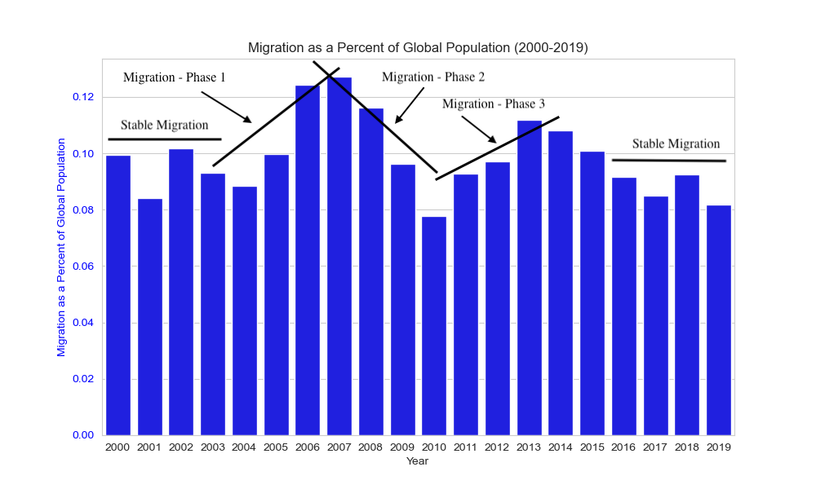
World Bank Net Migration Dataset - Global Migration has been surprisingly stable in this period - Two peak migrations can be observed 2007 and 2013 - We hypothesize that the first peak is due to this financial boom and bust center around 2008 - We hypothesize the second peak may be due to the political crisis in Syria started 2011
Global Migration and Population (2000-2019)

Slide 8
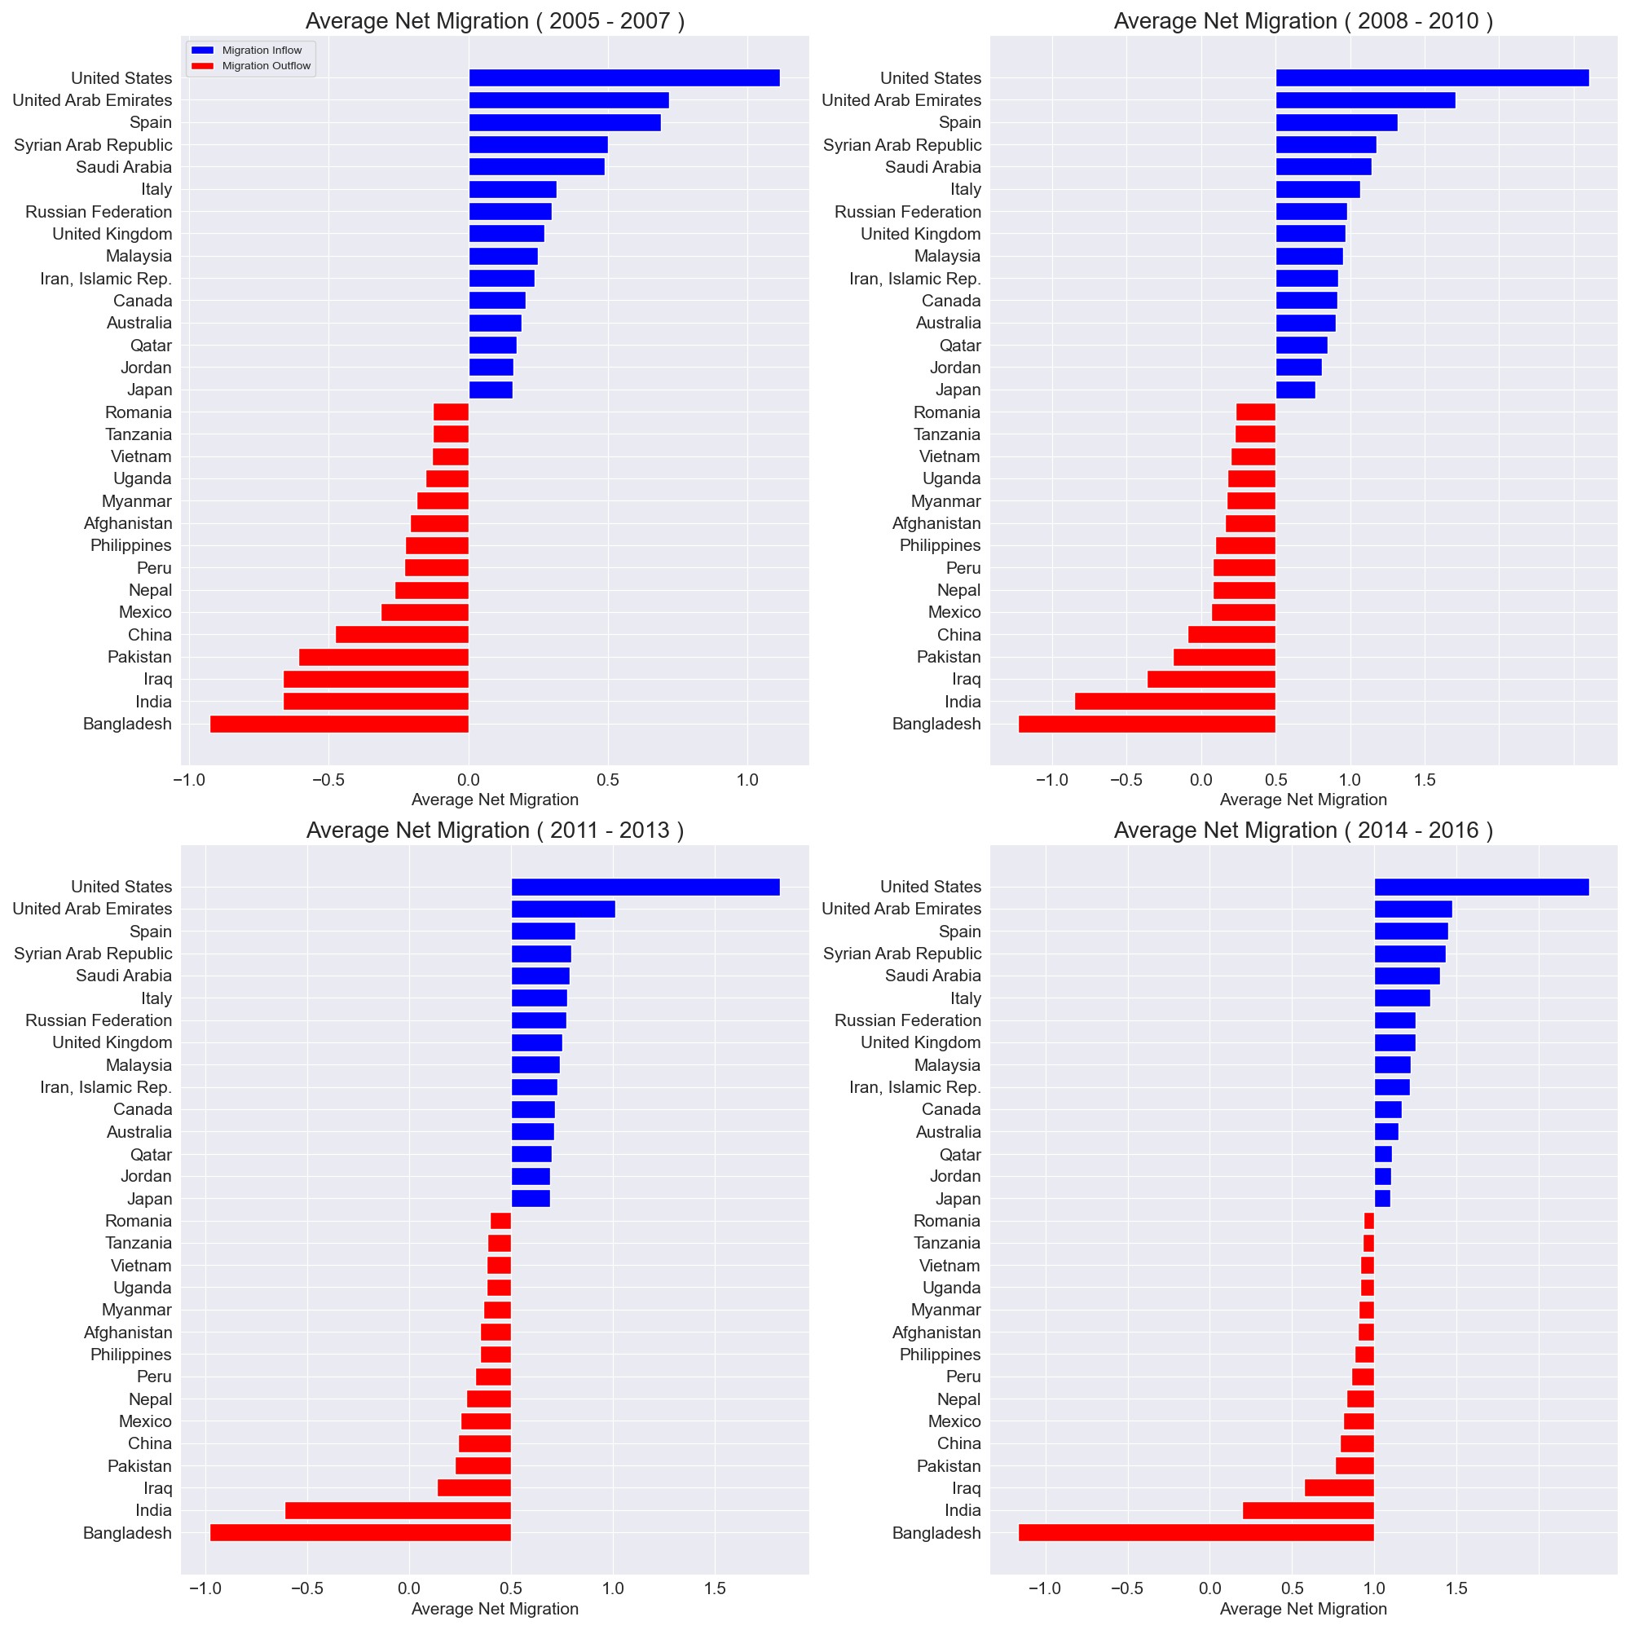
From these 4 summary charts of the top 15 inflow countries and bottom 15 outflows countries , we can see the following trends: - The top inflow countries are: United States, Europe and other wealthy countries - The top outflow countries are : India , China, Mexico, Philippines, Pakistan, Bangladesh and others. - Notice that total migration is high in the first decade and lower in the second decade.
Top 15 Inflows and Outflows (2000 -2019)

Slide 9
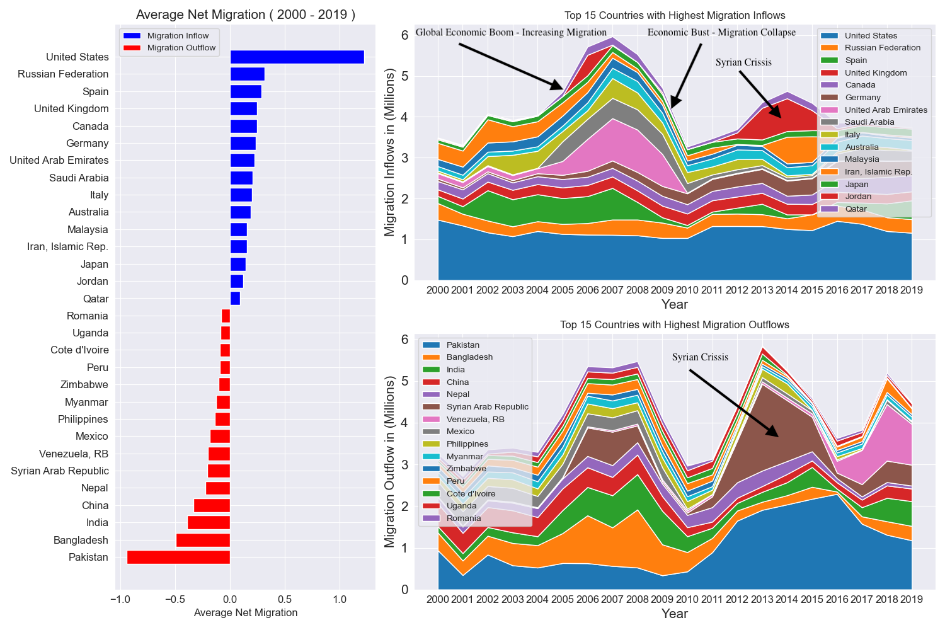
Observable Trends in Migration Data - 2008 Economic bubble Dramatic increase in migration flow before 2008. Dramatic decrease after financial collapse - 2011- 2015 Syria crisis We can clearly see in the lower chart outflow from Syria and upper chart inflow to Jordan is clearly seems to be related to the war in Syria - Migration Spike 2017 – 2018 Clearly visible in lower chart is dramatic outflow in Venezuela, this trend is not visible in upper chart
Global Migration Trends ( in Millions ) 2000 - 2019

Slide 10
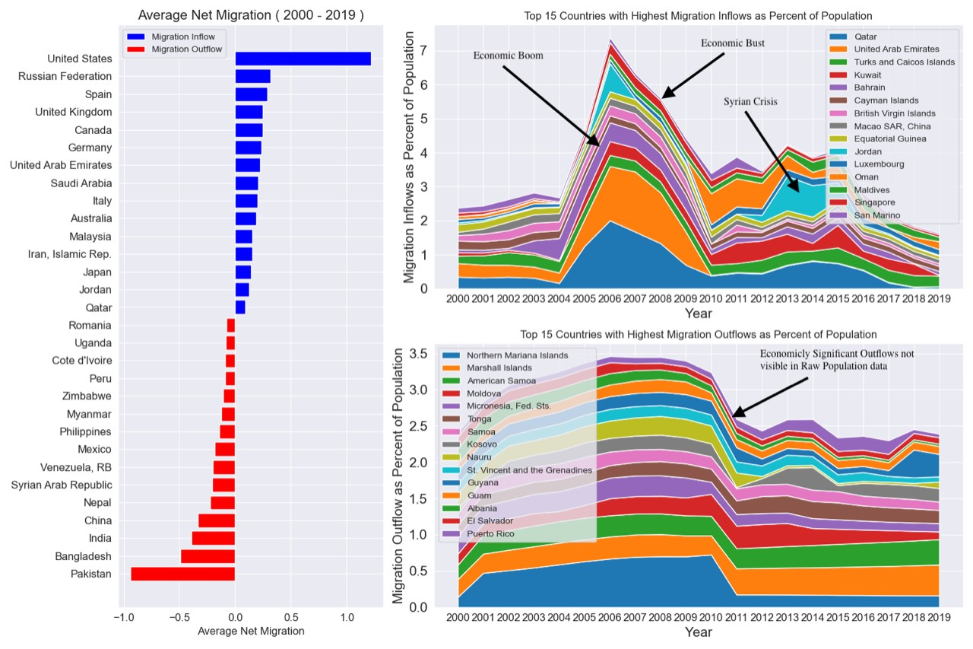
Global Migration Trends ( as Percent ) 2000 – 2019
Observable Trends in Per Capita Migration Data - 2008 Economic bubble Dramatic increase in migration flow before 2008. Dramatic decrease after financial collapse - 2011- 2015 Syria crisis We can clearly see in the lower chart outflow from Syria and upper chart inflow to Jordan is clearly seems to be related to the war in Syria - Migration Spike 2017 – 2018 Clearly visible in lower chart is dramatic outflow in Venezuela, this trend is not visible in upper chart

Slide 11
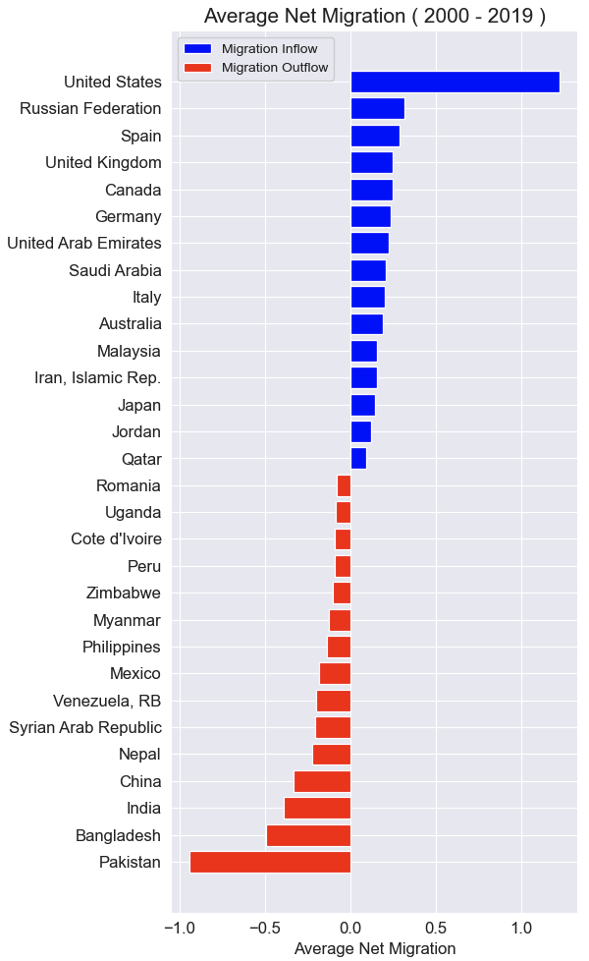
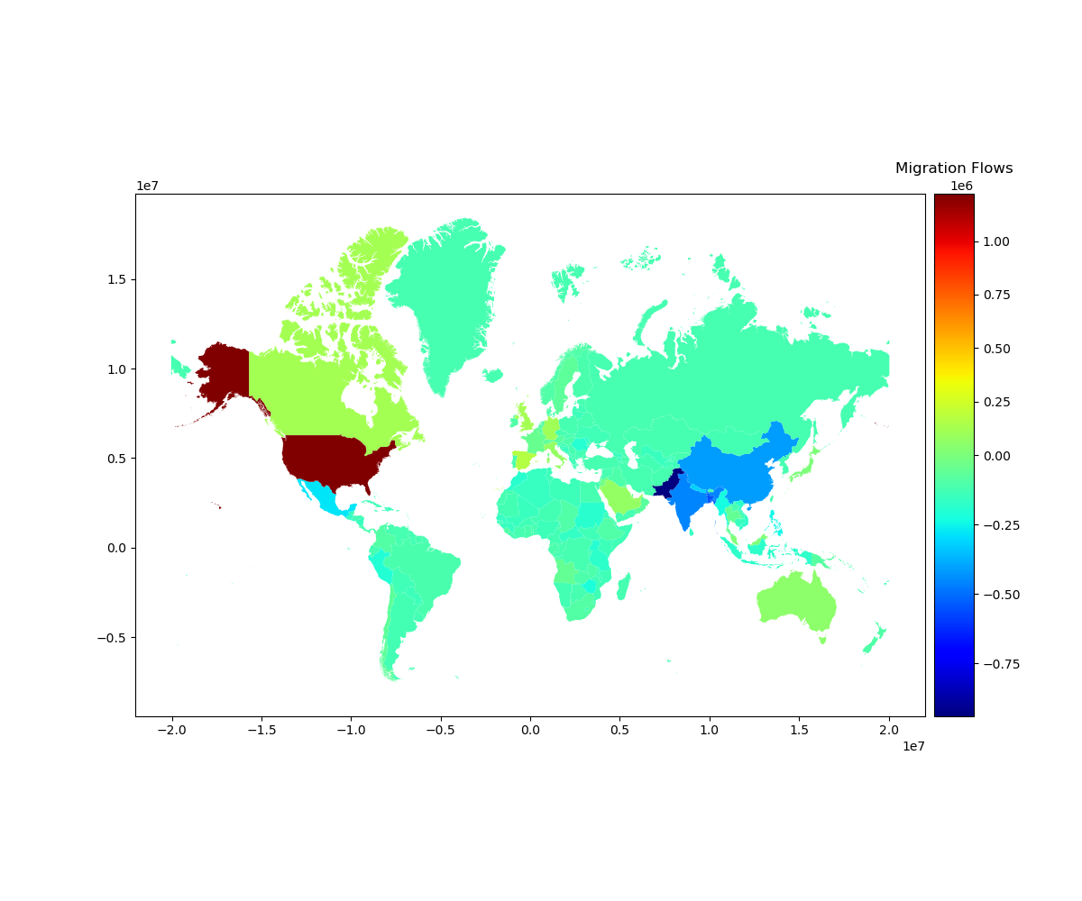
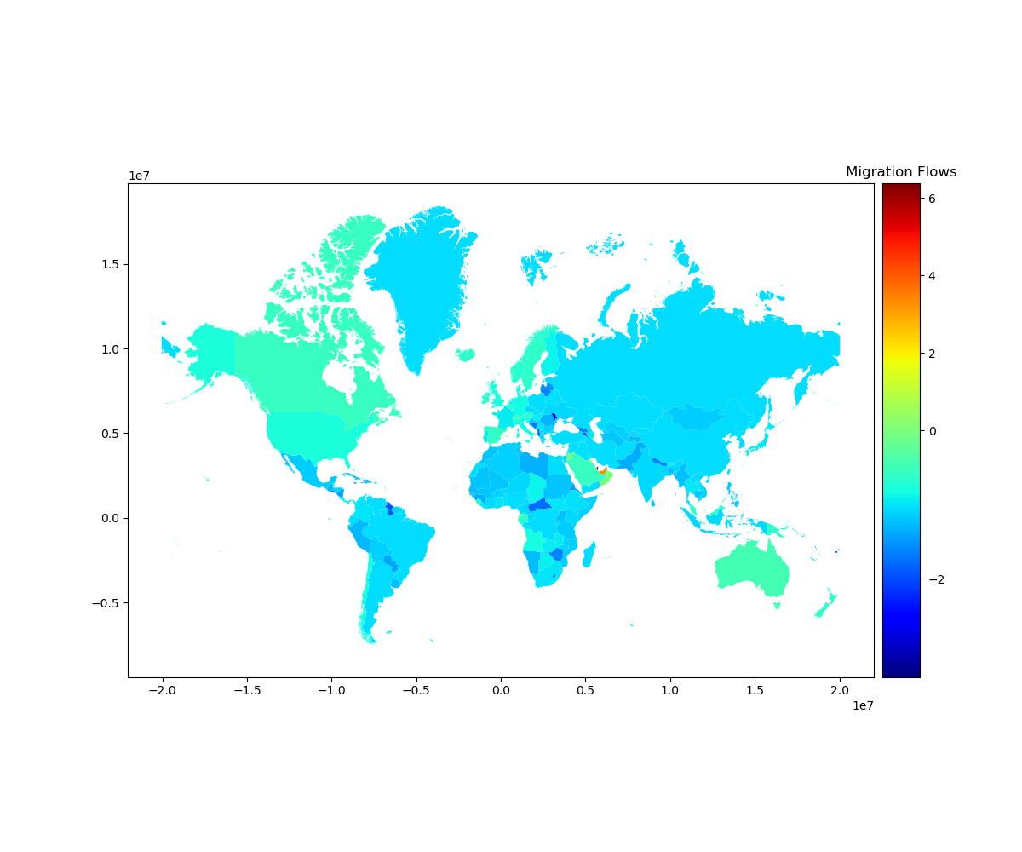
- Map composed of colored polygons - Heatmap with geographic Boundaries - Socio –economics data
Global Migration Trends ( as cloropleth ) 2000 – 2019

Slide 12
Global Financial Environment The impact of globalization and increasing economic opportunities can clearly be seen as a driver of migration from 2004 to 2007. The global financial crisis in 2008 is almost certainly the cause of the dramatic decline in migration from 2008 – 2010 and is clearly seen in both the net migration and per capita migration charts. In the per capita outflow chart we can clearly see important trends in a number of small counties that are not evident in the net migration charts. This demonstrates the value of engineered features and suggest that other derived features could be used to identify and analyze trends in this data set.
Global Migration Flow Analysis

Slide 13
Syrian Crisis This data set can also be used to identify and analyze the impact of political crisis or natural disasters. In particular the war in Syria lead to massive migration flows out of Syria and into Europe and the Middle East The Syrian diaspora can clearly be seen in the net migration chart, with large inflows to Jordan and Iran in 2014 - 2015. In the net migration outflow chart we can clearly see the exodus from Syria in 2013 – 2016. Additionally we can see large outflows in Pakistan and Venezuela but we do not analyze those trends here.
Global Migration Event Analysis

Slide 14
Global Migration We would suggest expanding the data to include : - Data set with both the source and destination countries - Data set with remittances by country and year - Higher frequency data - Utilization of Machine Learning algorithms This should allow us to explore a broader range of issues to include : - Complexity and Diversity - Demographic Impact - Economic Contribution - Challenges and Opportunities - Humanitarians Concerns - Policy and Governances - Globalization and Connectivity
Conclusion and Future Work

